Slide 1

Organization

Slide 2
Our DNA
2
Our Vision | We connect countries across oceans sustainably
Our Mission | We develop, fund and operate digital infrastructures in the Asia-Pacific region
Our Values | Quality, Innovation, Collaboration, Customer centricity
Our Values
Quality
I plan, organize, make the extra effort and preparation. I learn from my mistakes and document my learnings. I deliver on time and on quality. I seek information to make decisions and solve problems.
Innovation
I explore innovation in the market, and I use tools and techniques to explore new ideas. I adapt to changing environments. I engage in and suggest innovative ways of working (continuous improvement) I am self aware, open minded, continuously identifying opportunities for skill growth.
Collaboration
We work together to solve clients challenges and call on others to contribute. I empower my colleagues in their work. I respect the views of others and recognizes the impact of self on team culture. I communicate in a timely and effective manner.
Customer centricity
I continuously listen to my clients, understand their needs, and respond consistently in a timely manner. I think outside the box to support customers. I deliver outstanding customer experiences. I proactively anticipate customer needs.
  Employee Value Proposition
  Participate to unique, strategic, exciting infrastructure projects in the digital world.
  Agile and innovative start-up DNA, supported by a robust global business (BW Group)
  Learning and growing opportunities, accountability, life balance, diversity & collaboration
  Impactful and part of the decarbonizing effort of BW Group

Slide 3





New organisation
3
  Management team
Ludovic Hutier
Chief Executive Officer
Peter Missingham
General Counsel
Laurent Le Breton
Chief Financial Officer
Virginie Frouin
Chief Technical Officer
Hamid Maani
Chief Sales Officer
NZ based
AU based
Other location based
Contractor

Slide 4
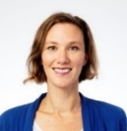

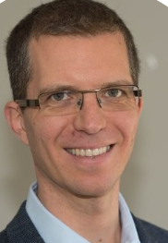
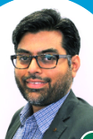



New organisation
4
NZ based
  Human Resources - Finance - Sales teams
AU based
Ludovic Hutier
Chief Executive Officer
Other location based
Contractor
Peter Missingham
General Counsel
Laurent Le Breton
Chief Financial Officer
Virginie Frouin
Chief Technical Officer
Hamid Maani
Chief Sales Officer
Marie Leclerc
HR Director
Janice Dcunha
Financial Controller
Pierre-Em. Goiffon
Director Bid & Contract
Faisal Hayat
Senior Manager Bid & Contract
Sheryl Pinto
Accounting Assistant
Gina Bohreer
S-VP Bus Dev - US
Stefan Zaal
Sales Manager - ANZ

Slide 5






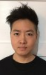

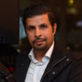
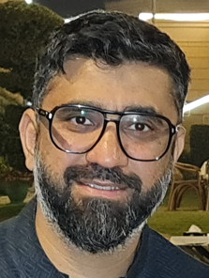






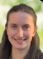






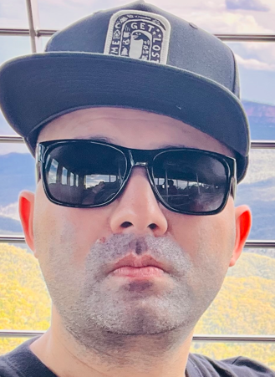
New organisation
5
  Operations teams
Ludovic Hutier
Chief Executive Officer
Graham Bruce
Director
Operations & Quality
John Bradfield
Maintenance Authority
Anael Greiveldinger
Director Engineering & IT
Dep. Director Operations
Saeed Khan
Global CLS Manager
Dep. Maintenance Manager
Thasa Balasubramaniam
Head of Provisioning
& Service Delivery
Ratnesh Pandit
Team Leader
Engineering & Trans
Oscar Yip
Full Stack
Developer
Vel. Sellakannu
Team Leader
IT - Infrastructure
Pat Curtis
Optical transmission Engineer
Oday Al Taai
Provisioning Engineer
Farhan Niwaz
Optical transmission Engineer
Akshat Tandon
Team Leader
IT - Development
Peter Tran
IT Infrastructure Engineer
Shane Wadworth
CLS Manager NZ
Anoop Russel
IT System
Engineer
Justin Spake
NOC Team Leader
Mohan Kidnapillai
CLS Manager AU
Margaux Faurie
IT PM Apprentice
Eugene Harris
NOC Engineer
Christian Alvaro
NOC Engineer
Dave Domeney
Support MK transition
NZ based
Other CLS Managers
Hawaii - DRF
Oregon - ACS
Am. Samoa - ASTCA
Umar Khayam
NOC Engineer
Parun Aroa
NOC Engineer
AU based
Other location based
Lawrence Conopio
NOC Engineer
Haribol Gautam
NOC Engineer
Contractor

Slide 6

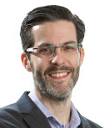

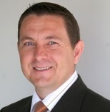


New organisation
6
  Submarine cable development team
Ludovic Hutier
Chief Executive Officer
Virginie Frouin
Chief Technical Officer
Cécile Durand
Programme Director
Marine
John Bradfield
Programme Director
CLS & OSP
Matt Whitlock
Project Director AU
Patrick Faidherbe
Programme Director
Supplier Contract
David Slessor
Project Director NZ
NZ based
AU based
Daniel McKeage
Project Coordinator
+ Acting PD INDO / US
Michael Wong
Project Director SG
Other location based
Contractor

Slide 7

New organisation
7
  Datacentre development team
Ludovic Hutier
Chief Executive Officer
Tamás Balogh
Programme Director
Datacentre
NZ based
AU based
Other location based
Contractor

